Slide 1
Mathematical Modeling of a Bi-factor Stem Cell Differentiation System
Fangrui (Lori) Liu
Youyuan Hu
Yuanchuan (Robert) Shao
Zhixiang (Carl) Yao
Oct. 2023

Slide 2
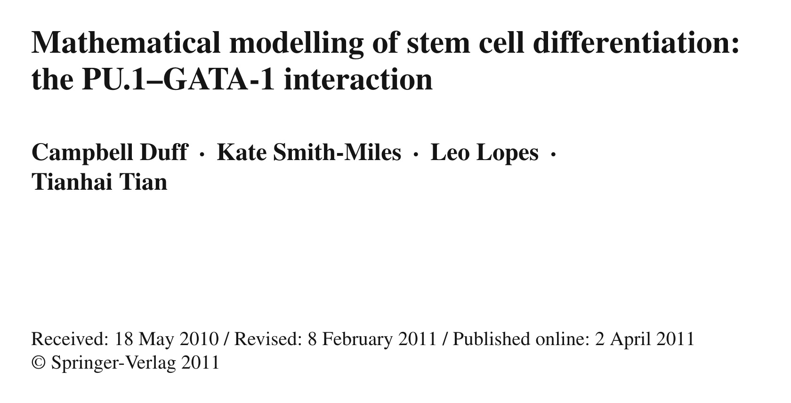

Slide 3
Content
The main purpose
Background
Two different mechanisms
A new mathematical model
Assumptions
Results and case study
Future work

Slide 4
The main purpose
Model the hematopoietic stem cell differentiation process using PU.1 and GATA-1.
Elucidate the regulatory mechanisms governing differentiation into erythrocyte/megakaryocyte and granulocyte/macrophage lineages.
Seek insights into the interplay between transcription factors PU.1 and GATA-1.
Provide opportunities for controlling stem cell development, with significant therapeutic implications.

Slide 5
Background
Hematopoietic stem cells are a type of multipotent stem cell can give rise to various blood cell types. This process, known as hematopoiesis, is essential for maintaining the body's blood cell balance and immune function.
HSCs can participate in generating cells across all hematopoietic lineages, ensuring a continuous supply of specialized cells to meet the organism's demands.
The regulation of directing undifferentiated stem or progenitor cells toward a specific hematopoietic lineage is referred to as lineage specification.

Slide 6
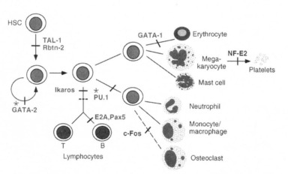
Schema depicting the positions of essential function of selected transcription factors in hematopoietic development. Positioning is based on the earliest block in differentiation resulting from absence of the designated factor. Only factors with a demonstrated role in hematopoietic differentiation.
(Shivdasani et al., 1996)
Notes:
Shivdasani, R. and Orkin, S. (1996) ‘The transcriptional control of hematopoiesis [see comments]’, Blood, 87(10), pp. 4025–4039. doi:10.1182/blood.v87.10.4025.bloodjournal87104025.

Slide 7
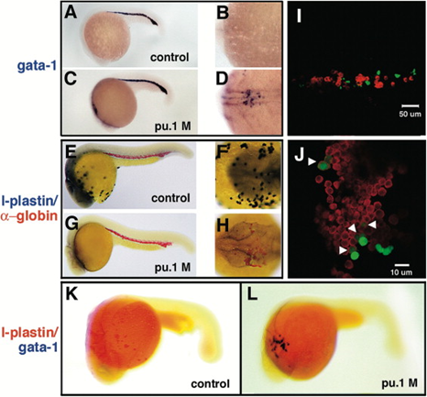
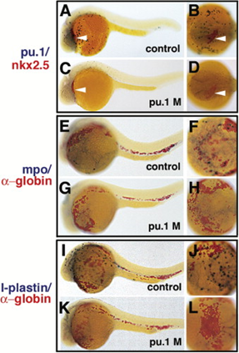
Pu.1 Suppresses Erythroid Development
Pu.1 Is Required for Myelopoiesis
(Rhodes et al., 2005)
Notes:
Figures: Rhodes, J. et al. (2005) ‘Interplay of pu.1 and Gata1 determines Myelo-erythroid progenitor cell fate in zebrafish’, Developmental Cell, 8(1), pp. 97–108. doi:10.1016/j.devcel.2004.11.014.

Slide 8
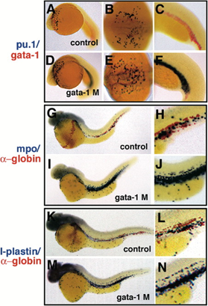
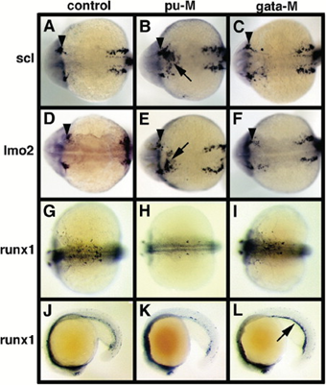
Gata1 Suppresses Myelopoiesis
Early Hematopoietic Gene Regulation by Pu.1 and Gata1
(Rhodes et al., 2005)
Notes:
Figures: Rhodes, J. et al. (2005) ‘Interplay of pu.1 and Gata1 determines Myelo-erythroid progenitor cell fate in zebrafish’, Developmental Cell, 8(1), pp. 97–108. doi:10.1016/j.devcel.2004.11.014.

Slide 9
Two different mechanisms
GATA-1 forms a complex with PU.1 by binding to its β3/β4 region. In this process, it displaces the co-activator c-Jun from its binding site on PU.1, leading to the inhibition of PU.1's transcription initiation.
The suppression of GATA-1 transcription occurs as a result of the interaction between the N-terminal segment of PU.1 and the C-finger region of GATA-1. This interaction effectively hinders GATA-1 from binding to its promoter.
(Roeder et al., 2006)
Notes:
Roeder, I. and Glauche, I. (2006) ‘Towards an understanding of lineage specification in hematopoietic stem cells: A mathematical model for the interaction of transcription factors GATA-1 and pu.1’, Journal of Theoretical Biology, 241(4), pp. 852–865. doi:10.1016/j.jtbi.2006.01.021.

Slide 10
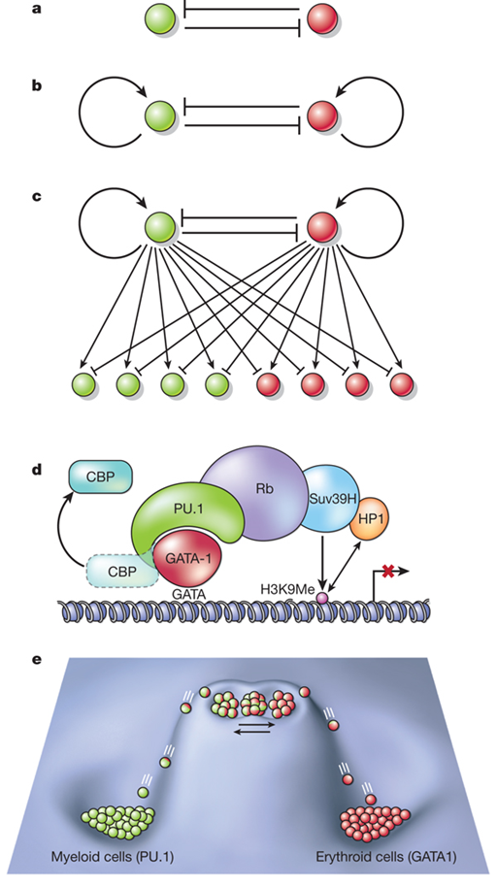
In General
We found an analysis of the four existing models and an alternative model which is shown to demonstrate a rich variety of dynamical systems behaviours found across the existing models, including both bistability and tristability required for modelling the undifferentiated progenitors.
(Duff et al., 2011)
Graf et al., 2009
Notes:
Figure: Graf, T. and Enver, T. (2009) ‘Forcing cells to change lineages’, Nature, 462(7273), pp. 587–594. doi:10.1038/nature08533.
Text: Duff, C. et al. (2011) ‘Mathematical modelling of stem cell differentiation: The pu.1–GATA-1 interaction’, Journal of Mathematical Biology, 64(3), pp. 449–468. doi:10.1007/s00285-011-0419-3.

Slide 11
Prediction
Problem:
Model this complex hematopoietic stem cell (HSC) differentiation process
Approach:
Make prediction by transcription Factors GATA-1 and PU.1
4 existing formalisms and a New Mathematical Model

Slide 12
Models Utilize Different Formalisms
Model using Shea-Ackers formalism
Assumed that both PU.1 and GATA-1 are autoregulatory through the binding of homodimers and these homodimers activate the expression of genes PU.1 and GATA-1.
Model using summed Hill formalism
Assumed that the production of both PU.1 and GATA-1 is autoregulatory and genes PU.1 and GATA-1 inhibit the production of each other.
Model with a master regulator gene
Gene X activated by GATA-1 and its product (protein X) inhibits the expression of gene PU.1
Model using the Michaelis–Menten formalism
Assumed that the PU.1 and GATA-1 transcriptional factors inhibit the production of each other, and this regulation was modelled by the production of an inactive heterodimer

Slide 13
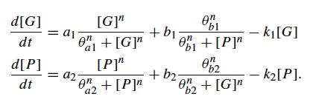
A New Mathematical Model
Demonstrate a rich variety of dynamical systems behaviors found across the existing models
Bistability
Tristability
(Required for modeling the undifferentiated progenitors)
The simulation results were supported by experimental data

Slide 14
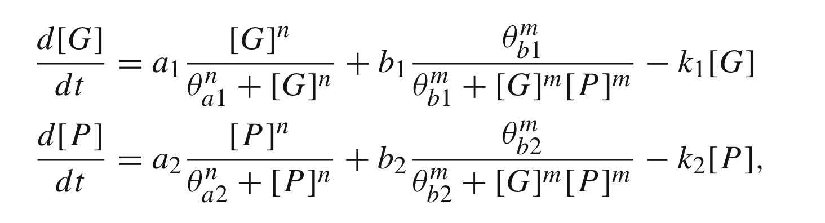
Parameters
gene expression by auto-stimulation
the cross-inhibition regulated by the other transcriptional factor in the network.
a first-order degradation of the transcriptional factor
[G] and [P]: expression levels of genes GATA-1 and PU.1, respectively.
a: the relative strength of the influence of the self-induction of GATA-1 or PU1.
b: the influence of the cross-inhibition on the basal activation.
k: the rate of first order deactivation
θ: the threshold (inflection point) of the explicitly sigmoidal functions, i.e., the strength of the regulatory interaction
n: Hill coefficient of autoregulation
m: antagonistic coefficient

Slide 15
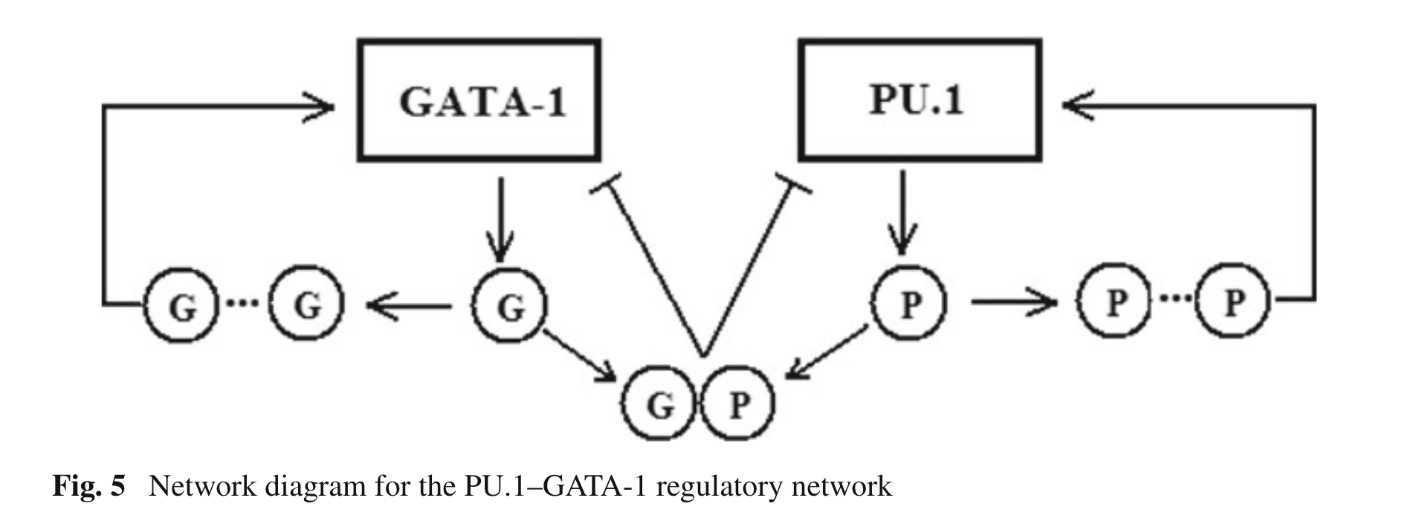
Assumptions on Network
The production of both PU.1 and GATA-1 is autoregulatory;
PU.1 and GATA-1 inhibit the production of each other through a PU.1–GATA-1 heterodimer;
There are independent binding site for the autoregulation and for the inhibition by the heterodimer;
The inhibition acts on a background expression term;
The concentrations of homodimers are assumed at equilibrium levels via the instantaneous dimer formation and dissolution;

Slide 16
Assumptions on Parameters and others
gene expression by auto-stimulation
the cross-inhibition regulated by the other transcriptional factor in the network.
a first-order degradation of the transcriptional factor
The Hill coefficient (n) for autoregulation was separated from the antagonism coefficient (m);
Time delays in transcription, transportation and translation are ignored;
To simplify the analysis, the system was modelled to be structurally symmetrical, i.e. the n and m were the same for GATA-1 and PU.1;
Monomeric bindings were not considered.

Slide 17
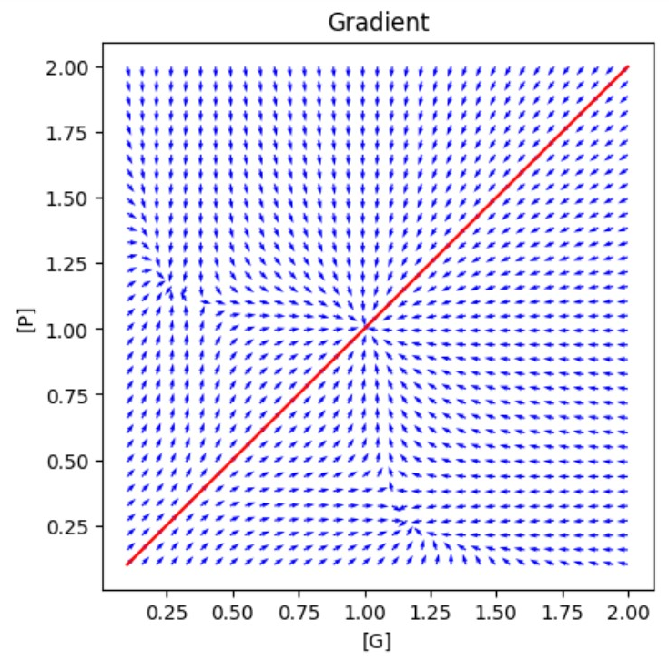
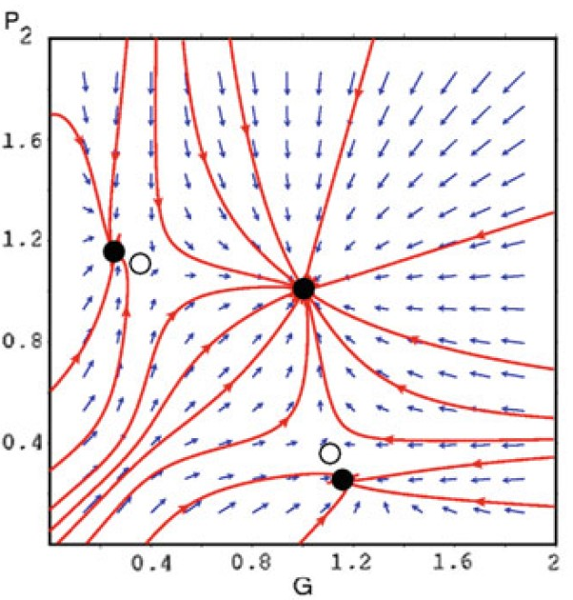
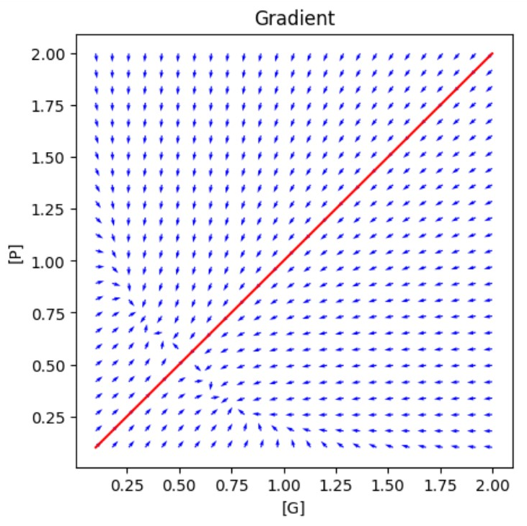
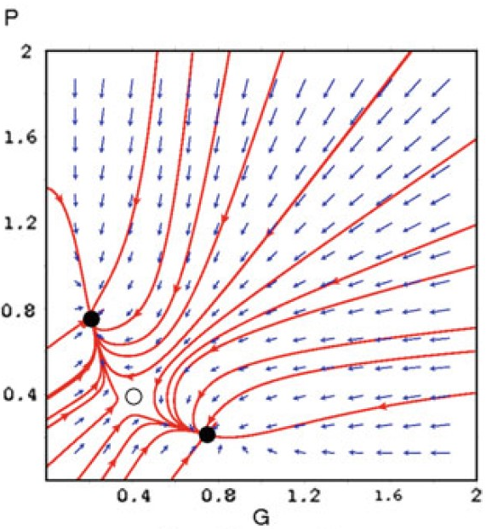
Results
a=0.6
Symmetric study:
a1=a2=a,
n = 4,m = 1,
b1 = b2 = 1,
θa1 = θa2 = 0.5,
θb1 = θb2 = 0.07,
k1 = k2 = 1
a=1

Slide 18
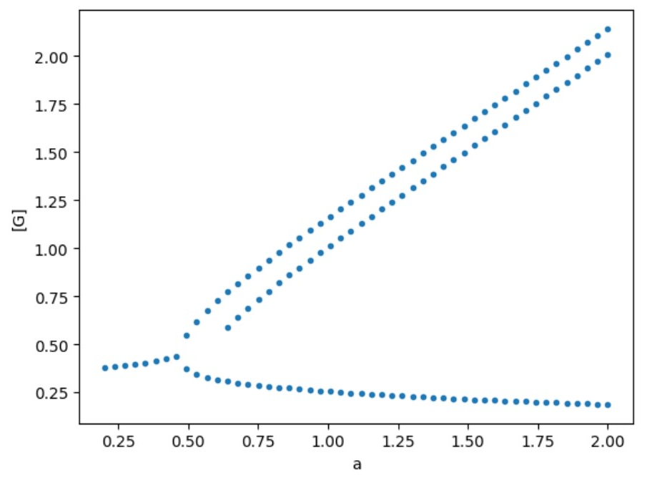
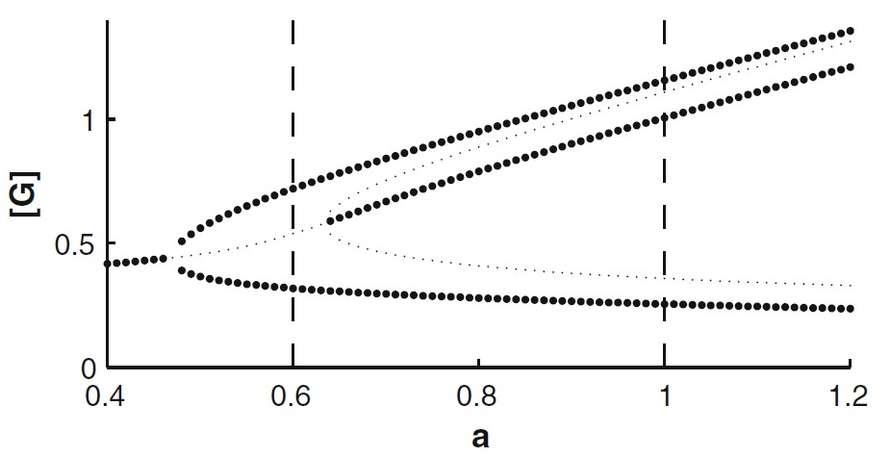
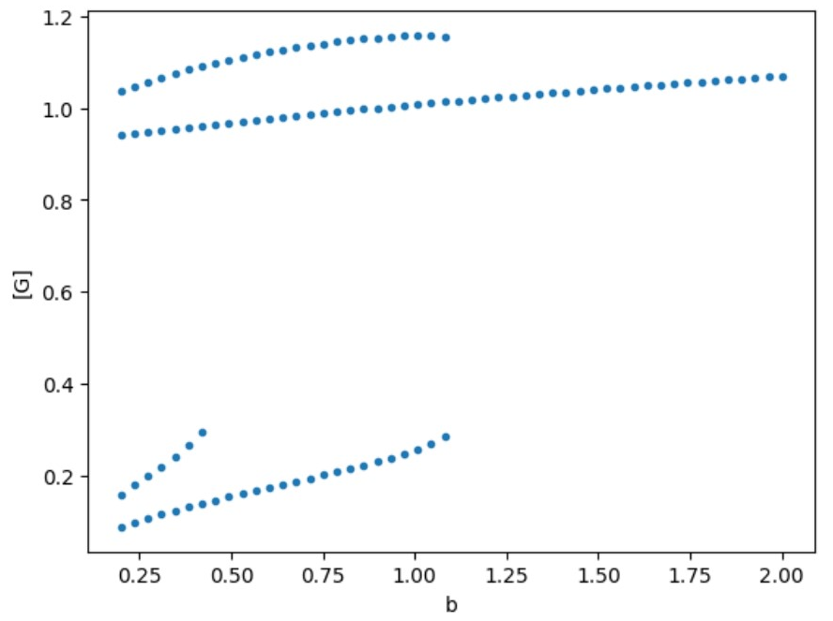
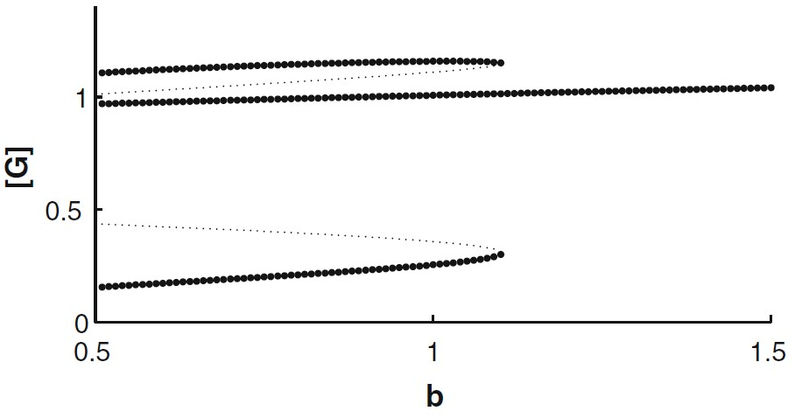
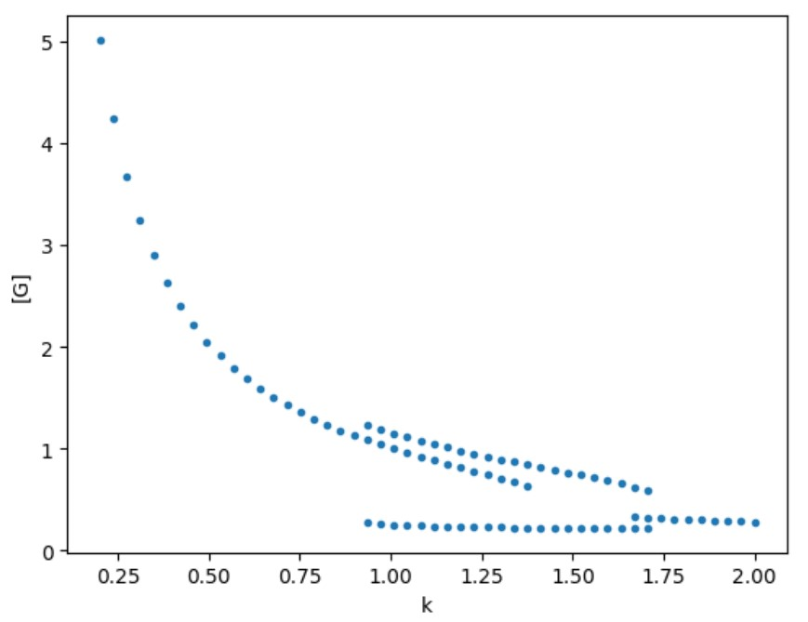
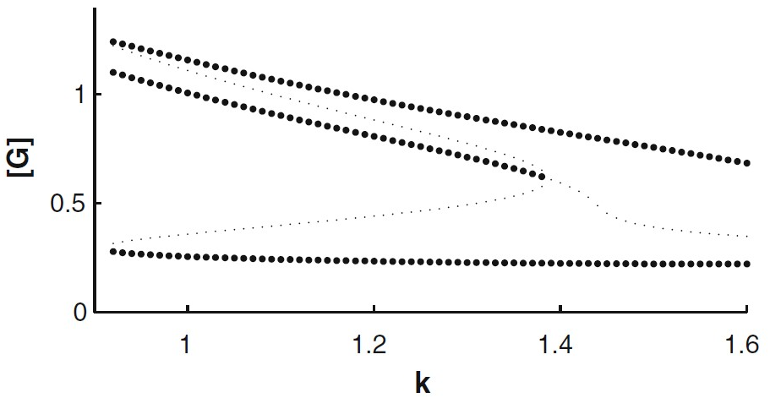
Results
k=1,b=1
Bifurcation analysis:
a1=a2=a,
b1 = b2 = b,
k1 = k2 = k,
n = 4,m = 1,
θa1 = θa2 = 0.5,
θb1 = θb2 = 0.07
k=1,a=1
a=1,b=1

Slide 19
Case Study
Autoregulation
Cross inhibition
Degradation

Slide 20
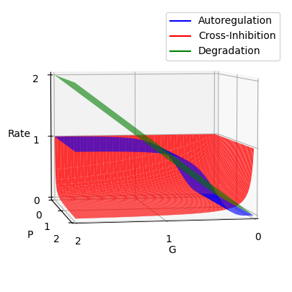
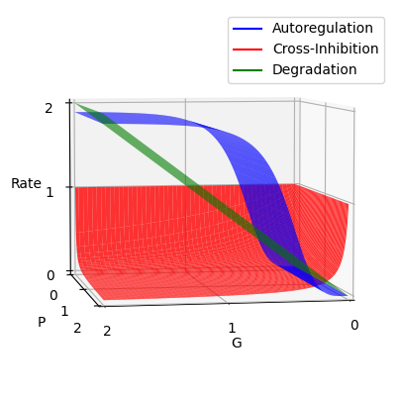
Case Study 1
Initial set up
a₁ = 1
𝜃_{a1} = 0.5
n = 4
b₁ = 1
𝜃_{b1} = 0.07
m = 1
k1 = 1
Change:
a₁ = 1.9
Lower a
higher a

Slide 21
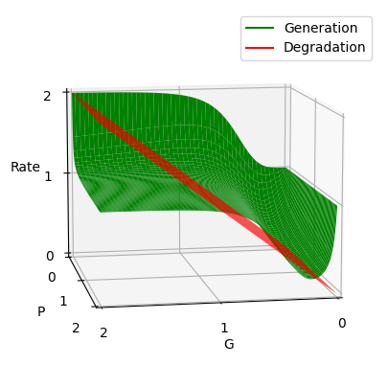
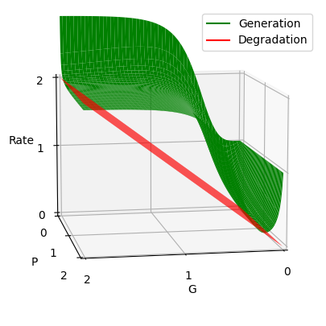
Case Study 1
Initial set up
a₁ = 1
𝜃_{a1} = 0.5
n = 4
b₁ = 1
𝜃_{b1} = 0.07
m = 1
k1 = 1
Change:
a₁ = 1.9
Lower a
higher a

Slide 22
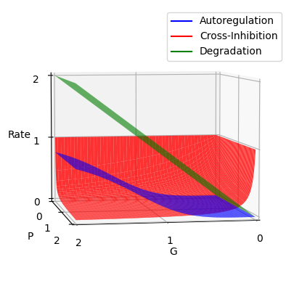
Case Study 2
Initial set up
a₁ = 1
𝜃_{a1} = 0.5
n = 4
b₁ = 1
𝜃_{b1} = 0.07
m = 1
k1 = 1
Change:
𝜃_{a1} = 1.5
Lower 𝜃_{a}
higher 𝜃_{a}

Slide 23
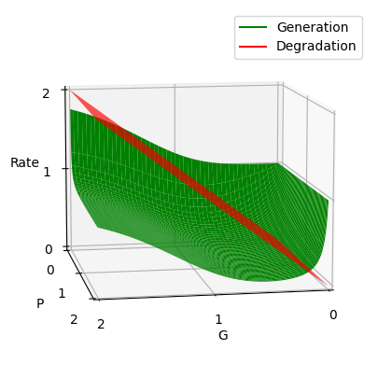
Case Study 2
Initial set up
a₁ = 1
𝜃_{a1} = 0.5
n = 4
b₁ = 1
𝜃_{b1} = 0.07
m = 1
k1 = 1
Change:
𝜃_{a1} = 1.5
Lower 𝜃_{a}
higher 𝜃_{a}

Slide 24
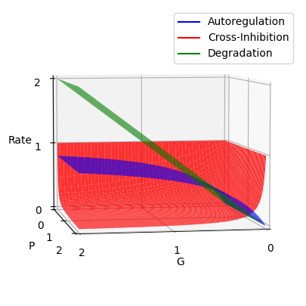
Case Study 3
Initial set up
a₁ = 1
𝜃_{a1} = 0.5
n = 4
b₁ = 1
𝜃_{b1} = 0.07
m = 1
k1 = 1
Change:
n = 1
higher n
lower n

Slide 25
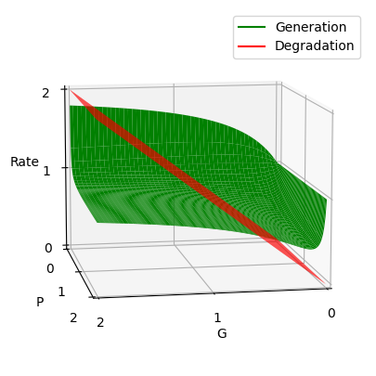
Case Study 3
Initial set up
a₁ = 1
𝜃_{a1} = 0.5
n = 4
b₁ = 1
𝜃_{b1} = 0.07
m = 1
k1 = 1
Change:
n = 1
higher n
lower n

Slide 26
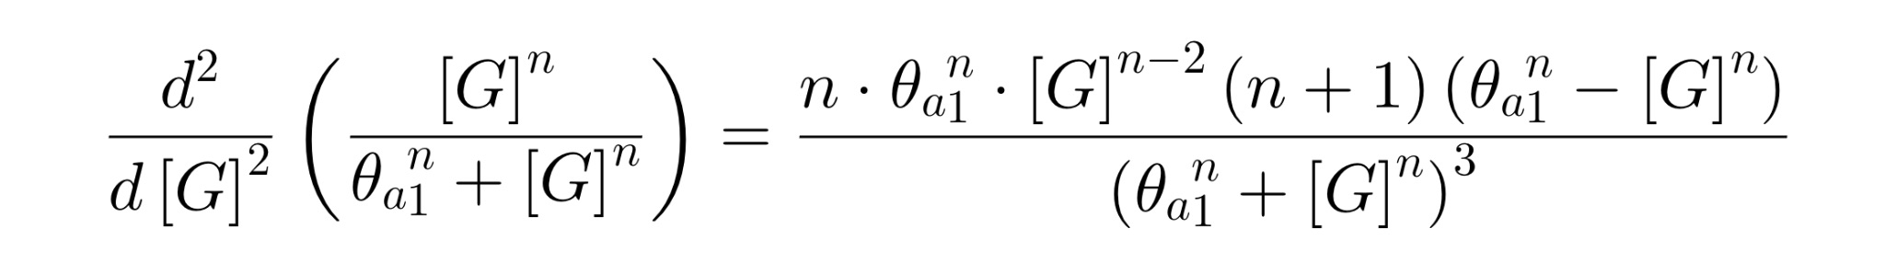
Case Study - Auto Regulation
a₁ determines the max contribution of autoregulation (AR), where GATA-1 concentration is high
𝜃_{a1} affects the AR’s contribution at low GATA-1 concentration; when [G] = 𝜃_{a1} , AR = a₁/2 → “threshold”
n manipulates the shape of the autoregulation curve; in other words, the slope at [G] = 𝜃_{a1}

Slide 27
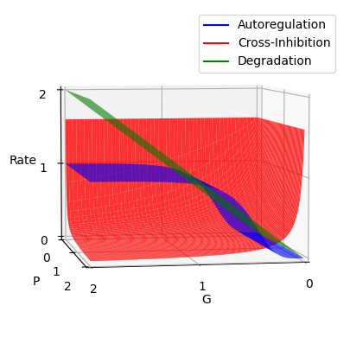
Case Study 4
Initial set up
a₁ = 1
𝜃_{a1} = 0.5
n = 4
b₁ = 1
𝜃_{b1} = 0.07
m = 1
k1 = 1
Change:
b₁ = 1.5
Lower b
higher b

Slide 28
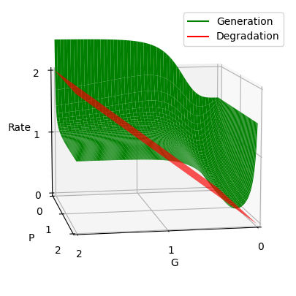
Case Study 4
Initial set up
a₁ = 1
𝜃_{a1} = 0.5
n = 4
b₁ = 1
𝜃_{b1} = 0.07
m = 1
k1 = 1
Change:
b₁ = 1.5
Lower b
higher b

Slide 29
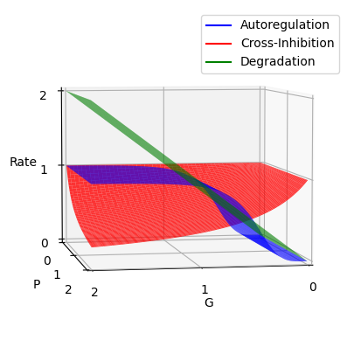
Case Study 5
Initial set up
a₁ = 1
𝜃_{a1} = 0.5
n = 4
b₁ = 1
𝜃_{b1} = 0.07
m = 1
k1 = 1
Change:
𝜃_{b1} = 1.20
Lower 𝜃_{b}
higher 𝜃_{b}

Slide 30
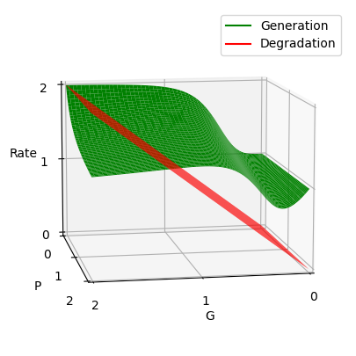
Case Study 5
Initial set up
a₁ = 1
𝜃_{a1} = 0.5
n = 4
b₁ = 1
𝜃_{b1} = 0.07
m = 1
k1 = 1
Change:
𝜃_{b1} = 1.20
Lower 𝜃_{b}
higher 𝜃_{b}

Slide 31
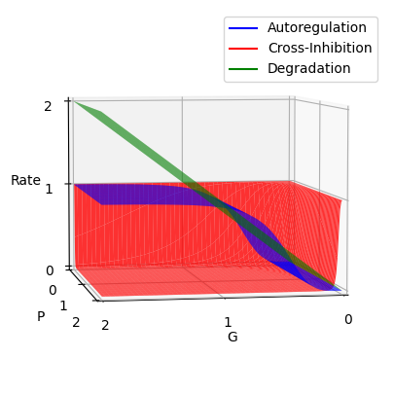
Case Study 6
Initial set up
a₁ = 1
𝜃_{a1} = 0.5
n = 4
b₁ = 1
𝜃_{b1} = 0.07
m = 1
k1 = 1
Change:
m = 4
Lower a
higher a

Slide 32
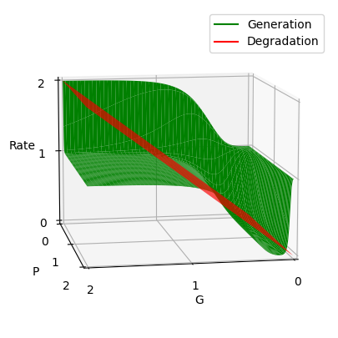
Case Study 6
Initial set up
a₁ = 1
𝜃_{a1} = 0.5
n = 4
b₁ = 1
𝜃_{b1} = 0.07
m = 1
k1 = 1
Change:
m = 4
Lower a
higher a

Slide 33
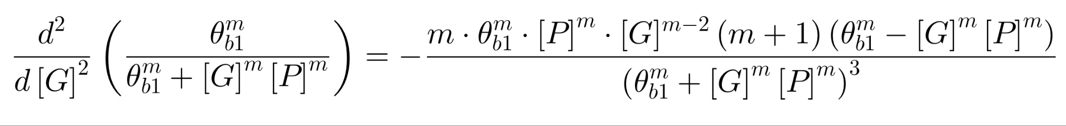
Case Study - Cross Inhibition
b₁ determines the max contribution of cross inhibition (CI), where both translation factors’ concentration are low
𝜃_{b1} affects the CI’s contribution at low GATA-1 concentration; when [G][P] = 𝜃_{b1} , CI = b₁/2 → “threshold”
m manipulates the shape of the cross inhibition curve; in other words, the slope at [G][P] = 𝜃_{b1}

Slide 34
Future Work
Try to use different machine learning models to perform curve fitting between all the parameters and the locations of corresponding steady states, thus accelerating the process of finding all the steady states.
Try to use Gillespie Algorithm to simulate the differentiation process of a cluster of cells and study the distribution of cells at different steady states.

Slide 35
Thank You!
Reference
Shivdasani, R. and Orkin, S. (1996) ‘The transcriptional control of hematopoiesis [see comments]’, Blood, 87(10), pp. 4025–4039. doi:10.1182/blood.v87.10.4025.bloodjournal87104025.
Rhodes, J. et al. (2005) ‘Interplay of pu.1 and Gata1 determines Myelo-erythroid progenitor cell fate in zebrafish’, Developmental Cell, 8(1), pp. 97–108. doi:10.1016/j.devcel.2004.11.014.
Duff, C. et al. (2011) ‘Mathematical modelling of stem cell differentiation: The pu.1–GATA-1 interaction’, Journal of Mathematical Biology, 64(3), pp. 449–468. doi:10.1007/s00285-011-0419-3.
Roeder, I. and Glauche, I. (2006) ‘Towards an understanding of lineage specification in hematopoietic stem cells: A mathematical model for the interaction of transcription factors GATA-1 and pu.1’, Journal of Theoretical Biology, 241(4), pp. 852–865. doi:10.1016/j.jtbi.2006.01.021.
Graf, T. and Enver, T. (2009) ‘Forcing cells to change lineages’, Nature, 462(7273), pp. 587–594. doi:10.1038/nature08533.

